Slide 1
Operating Systems
Deadlocks

Slide 2
Deadlock
In a multiprogramming environment, several processes may compete for a finite number of resources.
A process requests resources; if the resources are not available at that time, the process enters a waiting state.
Sometimes, a waiting process is never again able to change state, because the resources it has requested are held by other waiting processes.
This situation is called a deadlock.

Slide 3
System Model
System consists of resources
Resource types R1, R2, . . ., Rm
CPU cycles, memory space, I/O devices
Each process utilizes a resource as follows:
request - If the request cannot be granted immediately (for example, if the resource is being used by another process), then the requesting process must wait until it can acquire the resource
use - The process can operate on the resource
Release - The process releases the resource.
The request and release of resources may be system calls, Examples are the request() and release() device, open() and close() file, and allocate() and free() memory system calls.
Similarly, request and release of semaphores can be accomplished through the wait() and signal() operations on semaphores or through acquire() and release() of a mutex lock.

Slide 4
System Model
The resources may be either physical resources (for example, printers, tape drives, memory space, and CPU cycles) or logical resources (for example, semaphores, mutex locks, and files).
To illustrate a deadlocked state, consider a system with three CD RW drives. Suppose each of three processes holds one of these CDRW drives. If each process now requests another drive, the three processes will be in a deadlocked state.
Each is waiting for the event “CD RW is released,” which can be caused only by one of the other waiting processes. This example illustrates a deadlock involving the same resource type.
Deadlocks may also involve different resource types. For example, consider a system with one printer and one DVD drive. Suppose that process Pi is holding the DVD and process Pj is holding the printer. If Pi requests the printer and Pj requests the DVD drive, a deadlock occurs.

Slide 5
Deadlock Characterization
Mutual exclusion: only one process at a time can use a resource
Hold and wait: a process holding at least one resource is waiting to acquire additional resources held by other processes
No preemption: a resource can be released only voluntarily by the process holding it, after that process has completed its task
Circular wait: there exists a set {P0, P1, …, Pn} of waiting processes such that P0 is waiting for a resource that is held by P1, P1 is waiting for a resource that is held by P2, …, Pn–1 is waiting for a resource that is held by Pn, and Pn is waiting for a resource that is held by P0.

Slide 6
Resource-Allocation Graph
Deadlocks can be described more precisely in terms of a directed graph called a system resource-allocation graph.
A set of vertices V and a set of edges E.
V is partitioned into two types:
P = {P1, P2, …, Pn}, the set consisting of all the processes in the system
R = {R1, R2, …, Rm}, the set consisting of all resource types in the system
request edge – directed edge Pi → Rj
assignment edge – directed edge Rj → Pi

Slide 7
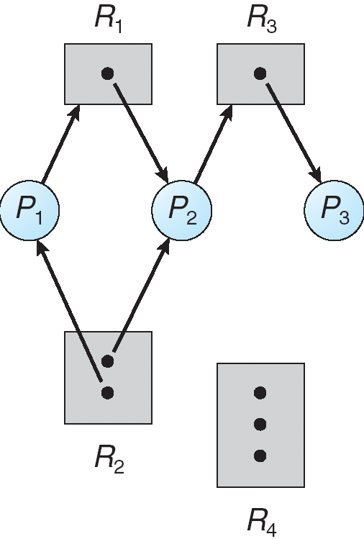
Example of a Resource Allocation Graph
The sets P, R, and E:
P = {P1, P2, P3}
R = {R1, R2, R3, R4}
E = {P1 → R1, P2 → R3, R1 → P2, R2 → P2, R2 → P1, R3 → P3}

Slide 8
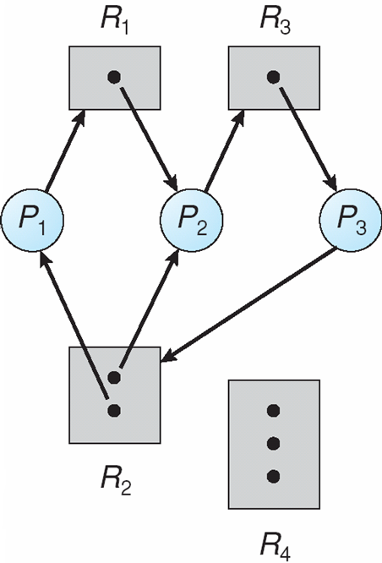
Resource Allocation Graph With A Deadlock

Slide 9
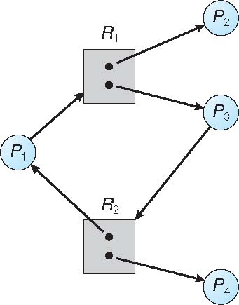
Graph With A Cycle But No Deadlock
If graph contains no cycles ⇒ no deadlock
If graph contains a cycle ⇒
if only one instance per resource type, then deadlock
if several instances per resource type, possibility of deadlock

Slide 10
Methods for Handling Deadlocks
Ensure that the system will never enter a deadlock state:
Deadlock prevention
Deadlock avoidance
Allow the system to enter a deadlock state and then recover
Ignore the problem and pretend that deadlocks never occur in the system; used by most operating systems, including UNIX and Windows
Deadlock prevention provides a set of methods to ensure that at least one of the necessary conditions cannot hold. Prevent deadlocks by constraining how requests for resources can be made.
Deadlock avoidance requires that the operating system be given additional information in advance concerning which resources a process will request and use during its lifetime

Slide 11
THANK YOU

